Slide 1
Infratech solutions
Eliscops

Slide 2
INTRODUCTION
In this project, our aim is to revolutionize the way site owners oversee their projects' progress. By leveraging a dynamic blend of cutting-edge technologies, including HTML, CSS, Node.js, MongoDB, Express.js, React, Tailwind, and Chart.js, we've crafted a sophisticated yet user-friendly dashboard. This dashboard empowers bridge owners to effortlessly track a multitude of critical metrics: daily work efficiency, pending tasks, budget allocations, departmental hierarchies, and the progress of various project segments.

Slide 3
problem
The challenge we're addressing stems from the fact that site owners, often non-technical individuals, grapple with the time-consuming task of manually supervising each department's progress. Their busy schedules leave them with limited opportunities to visit individual departments and comprehensively gauge the overall advancement of their project.

Slide 4





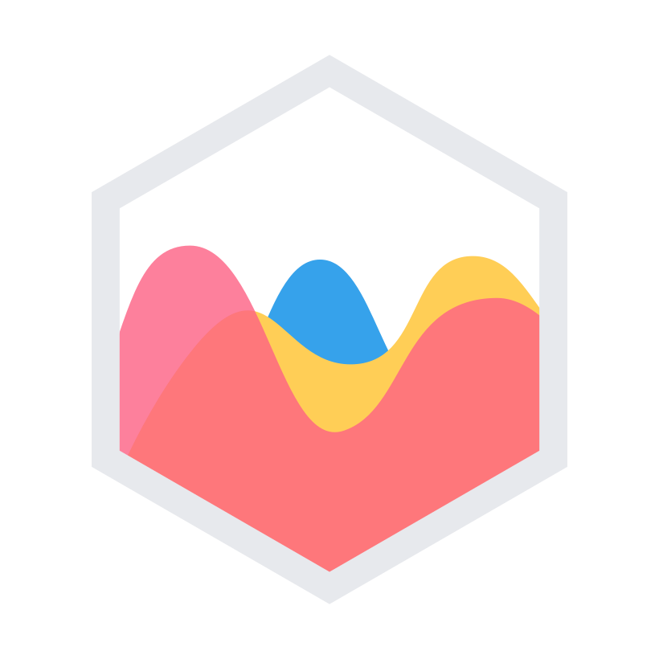
Languages and frameworks
javascripts
Node js
Express js
React js
React tailwind
Chart js

Slide 5
What we learn from this event ?
Collaboration:we would collaborate across diverse technical areas (frontend, backend, database) and build cohesive solutions.
Problem Solving: The team would face challenges in designing an intuitive user interface, managing data securely, and integrating various technologies.
Agile Development: The project could be approached using Agile methodologies, allowing the team to adapt to changing requirements and deliver iterative improvements.

Slide 6
Advantages of our web application
Time Efficiency: Site owners could effortlessly monitor site progress from a centralized dashboard, saving time and effort.
Data-Driven Insights: Visualizations through Chart.js would offer clear insights into daily work efficiency and budget allocation.
Task Management: Department heads could assign tasks and track their completion, fostering efficient task management.
Employee Empowerment: Employees would have a clear view of their tasks and accomplishments, enhancing their sense of contribution.

Slide 7
Innovations from the Web Application
Accessibility: The project bridges the gap between technical and non-technical users, enabling seamless tracking and reporting.
Real-Time Insights: The provision of real-time progress updates and visualizations empowers better decision-making.
Hierarchical Tracking: The hierarchical structure of access allows for precise oversight at different levels of the organization.

Slide 8
Business Benefits of Using the Web Application
Enhanced Efficiency: Site owners, department heads, and employees would experience streamlined tracking and task management.
Informed Decision-Making: Real-time insights into progress, efficiency, and budget allocation enable data-driven decisions.
Resource Optimization: Effective budget tracking helps optimize resource allocation and prevent overspending.
Scalability: The system can be expanded to accommodate larger projects and teams while maintaining user-friendly interfaces.

Slide 9
Functionaities of out projects
Owner's Dashboard
Department Heads' Dashboard
employee Dashboard
Visualizes daily work efficiency, helping owners make informed decisions.
Displays pending tasks, enabling efficient task prioritization.
Provides a budget overview, showing department-wise expenditure.
Maps out the hierarchical structure of departments and their heads.
Tracks sub-department progress, enhancing transparency.
Offers a similar interface to the owner's dashboard.
Enables the assignment of tasks to sub-departments.
Allows task completion marking for efficient tracking.
Allows employees to monitor their colleagues' progress.
Enables task completion marking, promoting accountability

Slide 11
OUT PUT

Slide 12
THANKS
Done By
Eliscops

